Slide 1
COM2067/ COM267
Chapter 15: Hashing and Collision
Data Structures Using C, Second Edition

Slide 2
Introduction
Hash Tables
Hash Functions
Collisions

Slide 3
Introduction
Linear search has a running time proportional to O(n), while binary search takes time proportional to O(log n), where n is the number of elements in the array.
Binary search and binary search trees are efficient algorithms to search for an element.
But what if we want to perform the search operation in time proportional to O(1)?
In other words, is there a way to search an array in constant time, irrespective of its size?

Slide 4
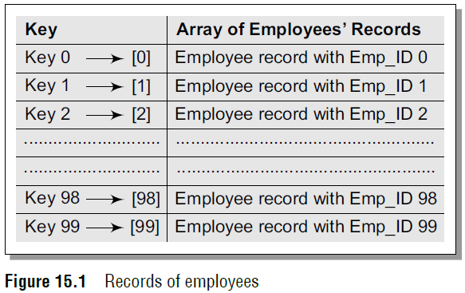
Introduction
There are two solutions to this problem.
Let us take an example to explain the first solution. In a small company of 100 employees, each employee is assigned an Emp_ID in the range 0–99.
To store the records in an array, each employee’s Emp_ID acts as an index into the array where the employee’s record will be stored as shown in Fig. 15.1.
In this case, we can directly access the record of any employee, once we know his Emp_ID, because the array index is the same as the Emp_ID number.
But practically, this implementation is hardly feasible.

Slide 5
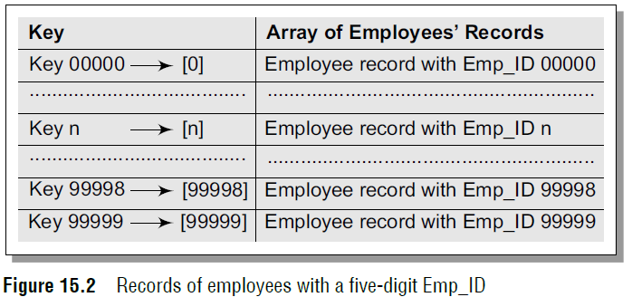
Introduction
Let us assume that the same company uses a five-digit Emp_ID as the primary key.
In this case, key values will range from 00000 to 99999. If we want to use the same technique as above, we need an array of size 100,000, of which only 100 elements will be used.
This is illustrated in Fig. 15.2.

Slide 6
Introduction
It is impractical to waste so much storage space just to ensure that each employee’s record is in a unique and predictable location.
Whether we use a two-digit primary key (Emp_ID) or a five-digit key, there are just 100 employees in the company.
Thus, we will be using only 100 locations in the array. Therefore, in order to keep the array size down to the size that we will actually be using (100 elements), another good option is to use just the last two digits of the key to identify each employee.
For example, the employee with Emp_ID 79439 will be stored in the element of the array with index 39.
Similarly, the employee with Emp_ID 12345 will have his record stored in the array at the 45th location.
In the second solution, the elements are not stored according to the value of the key.
So in this case, we need a way to convert a five-digit key number to a two-digit array index.
We need a function which will do the transformation. In this case, we will use the term hash table for an array and the function that will carry out the transformation will be called a hash function.

Slide 7
Hash Tables
Hash table is a data structure in which keys are mapped to array positions by a hash function.
In a hash table, an element with key k is stored at index h(k) and not k.
It means a hash function h is used to calculate the index at which the element with key k will be stored.
This process of mapping the keys to appropriate locations (or indices) in a hash table is called hashing.
Figure 15.4 shows a hash table in which each key from the set K is mapped to locations generated by using a hash function.
Note that keys k2 and k6 point to the same memory location.
This is known as collision. That is, when two or more keys map to the same memory location, a collision is said to occur.
Similarly, keys k5 and k7 also collide. The main goal of using a hash function is to reduce the range of array indices that have to be handled.

Slide 8
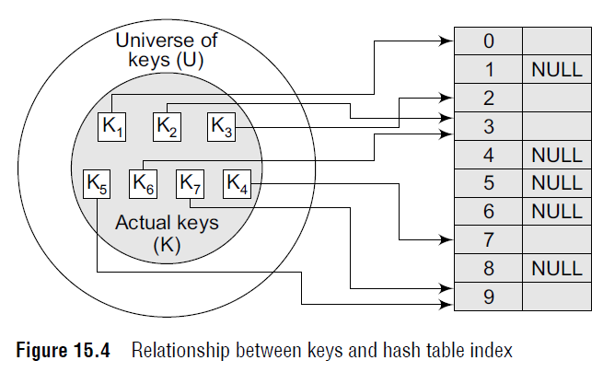
Hash Tables

Slide 9
Hash Functions
A hash function is a mathematical formula which, when applied to a key, produces an integer which can be used as an index for the key in the hash table.
The main aim of a hash function is that elements should be relatively, randomly, and uniformly distributed.
It produces a unique set of integers within some suitable range in order to reduce the number of collisions.
In practice, there is no hash function that eliminates collisions completely.
A good hash function can only minimize the number of collisions by spreading the elements uniformly throughout the array.

Slide 10
Hash Functions
Properties of a Good Hash Function
Low cost The cost of executing a hash function must be small, so that using the hashing technique becomes preferable over other approaches.
For example, if binary search algorithm can search an element from a sorted table of n items with log₂n key comparisons, then the hash function must cost less than performing log₂n key comparisons.
Determinism A hash procedure must be deterministic.
This means that the same hash value must be generated for a given input value.
However, this criteria excludes hash functions that depend on external variable parameters (such as the time of day) and on the memory address of the object being hashed (because address of the object may change during processing).
Uniformity A good hash function must map the keys as evenly as possible over its output range.
This means that the probability of generating every hash value in the output range should roughly be the same.
The property of uniformity also minimizes the number of collisions.

Slide 11
Different Hash Functions
In this section, we will discuss the hash functions which use numeric keys.
However, there can be cases in real-world applications where we can have alphanumeric keys rather than simple numeric keys.
In such cases, the ASCII value of the character can be used to transform it into its equivalent numeric key.
Once this transformation is done, any of the hash functions given below can be applied to generate the hash value.

Slide 12
Different Hash Functions
Division Method
It is the most simple method of hashing an integer x.
This method divides x by M and then uses the remainder obtained.
In this case, the hash function can be given as
h(x) = x mod M
The division method is quite good for just about any value of M and since it requires only a single division operation, the method works very fast.
However, extra care should be taken to select a suitable value for M.

Slide 13
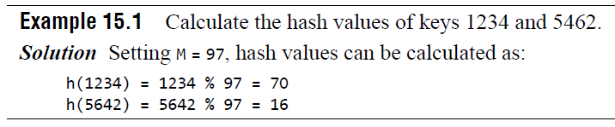
Different Hash Functions
Division Method
Generally, it is best to choose M to be a prime number because making M a prime number increases the likelihood that the keys are mapped with a uniformity in the output range of values.
The division method is extremely simple to implement.
The following code segment illustrates how to do this:
int const M = 97; // a prime number
int h (int x)
{ return (x % M); }

Slide 14
Different Hash Functions
Division Method
A potential drawback of the division method is that while using this method, consecutive keys map to consecutive hash values.
On one hand, this is good as it ensures that consecutive keys do not collide, but on the other, it also means that consecutive array locations will be occupied.
This may lead to degradation in performance.

Slide 15
Different Hash Functions
Multiplication Method
The steps involved in the multiplication method are as follows:
Step 1: Choose a constant A such that 0 < A < 1.
Step 2: Multiply the key k by A.
Step 3: Extract the fractional part of kA.
Step 4: Multiply the result of Step 3 by the size of hash table (m).
Hence, the hash function can be given as:
h(k) = m (kA mod 1)
where (kA mod 1) gives the fractional part of kA and m is the total number of indices in the hash table.

Slide 16
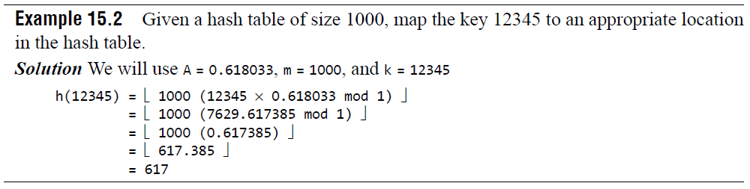
Different Hash Functions
Multiplication Method
The greatest advantage of this method is that it works practically with any value of A.
Although the algorithm works better with some values, the optimal choice depends on the characteristics of the data being hashed.
Knuth has suggested that the best choice of A is
(sqrt5 – 1) /2 = 0.6180339887

Slide 17
Different Hash Functions
Mid-square Method
The mid-square method is a good hash function which works in two steps:
Step 1: Square the value of the key. That is, find k².
Step 2: Extract the middle r digits of the result obtained in Step 1.
The algorithm works well because most or all digits of the key value contribute to the result.
This is because all the digits in the original key value contribute to produce the middle digits of the squared value.
Therefore, the result is not dominated by the distribution of the bottom digit or the top digit of the original key value.
In the mid-square method, the same r digits must be chosen from all the keys.
Therefore, the hash function can be given as:
h(k) = s
where s is obtained by selecting r digits from k².

Slide 18
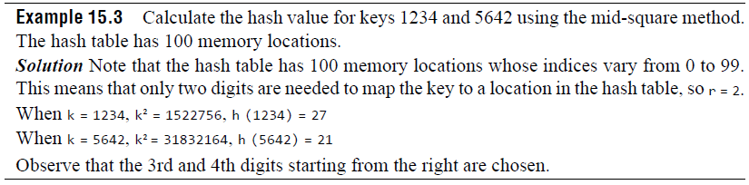
Different Hash Functions
Mid-square Method

Slide 19
Different Hash Functions
Folding Method
The folding method works in the following two steps:
Step 1: Divide the key value into a number of parts.
That is, divide k into parts k₁, k₂, ..., k_{n}, where each part has the same number of digits except the last part which may have lesser digits than the other parts.
Step 2: Add the individual parts. That is, obtain the sum of k₁ + k₂ + ... + k_{n}.
The hash value is produced by ignoring the last carry, if any.
Note that the number of digits in each part of the key will vary depending upon the size of the hash table.
For example, if the hash table has a size of 1000, then there are 1000 locations in the hash table.
To address these 1000 locations, we need at least three digits; therefore, each part of the key must have three digits except the last part which may have lesser digits.

Slide 20
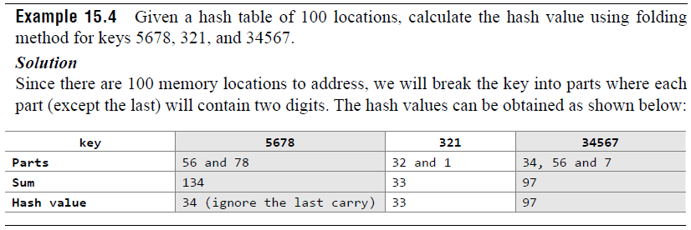
Different Hash Functions
Folding Method

Slide 21
Collisions
As discussed earlier in this chapter, collisions occur when the hash function maps two different keys to the same location.
Obviously, two records cannot be stored in the same location.
Therefore, a method used to solve the problem of collision, also called collision resolution technique, is applied.
The two most popular methods of resolving collisions are:
1. Open addressing
2. Chaining
In this section, we will discuss both these techniques in detail.

Slide 22
Collisions
Collision Resolution by Open Addressing
Once a collision takes place, open addressing or closed hashing computes new positions using a probe sequence and the next record is stored in that position.
In this technique, all the values are stored in the hash table.
The hash table contains two types of values: sentinel values (e.g., –1) and data values.
The presence of a sentinel value indicates that the location contains no data value at present but can be used to hold a value.
When a key is mapped to a particular memory location, then the value it holds is checked.
If it contains a sentinel value, then the location is free and the data value can be stored in it.
However, if the location already has some data value stored in it, then other slots are examined systematically in the forward direction to find a free slot.
If even a single free location is not found, then we have an OVERFLOW condition.
The process of examining memory locations in the hash table is called probing.
Open addressing technique can be implemented using linear probing, quadratic probing, double hashing, and rehashing.

Slide 23
Collisions
Linear Probing
The simplest approach to resolve a collision is linear probing.
In this technique, if a value is already stored at a location generated by h(k), then the following hash function is used to resolve the collision:
h(k, i) = [h′(k) + i] mod m
where m is the size of the hash table,
h′(k) = (k mod m), and i is the probe number that varies from 0 to m–1.

Slide 24
Collisions
Linear Probing
Therefore, for a given key k, first the location generated by [h′(k) mod m] is probed because for the first time i=0.
If the location is free, the value is stored in it, else the second probe generates the address of the location given by [h′ (k) + 1]mod m.
Similarly, if the location is occupied, then subsequent probes generate the address as [h′(k) + 2]mod m, [h′(k) + 3]mod m, [h′(k) + 4]mod m, [h′(k)+ 5]mod m, and so on, until a free location is found.

Slide 25
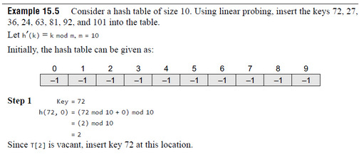

Collisions
Linear Probing

Slide 26
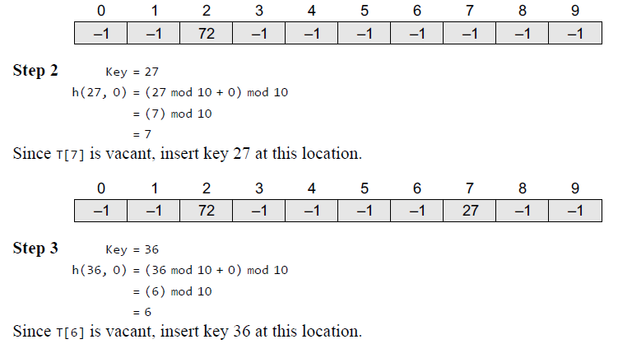
Collisions
Linear Probing

Slide 27
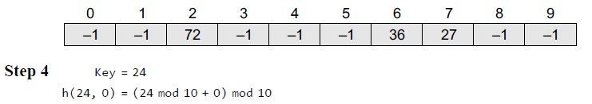
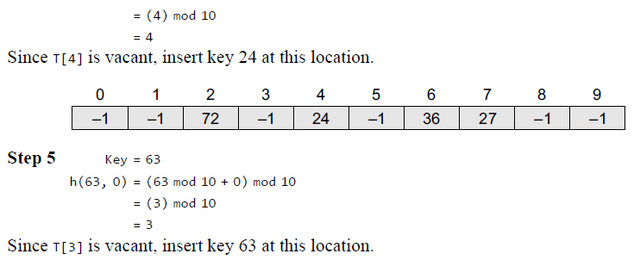
Collisions
Linear Probing

Slide 28
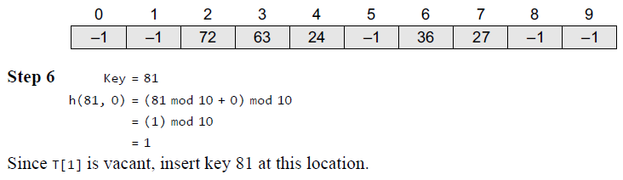
Collisions
Linear Probing

Slide 29
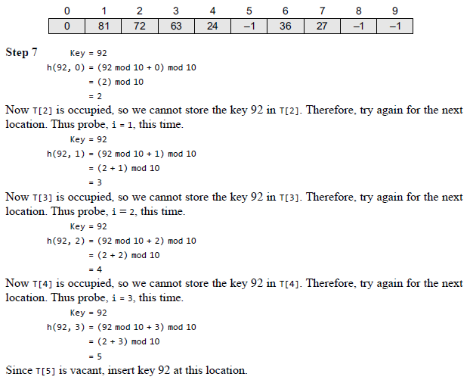
Collisions
Linear Probing

Slide 30
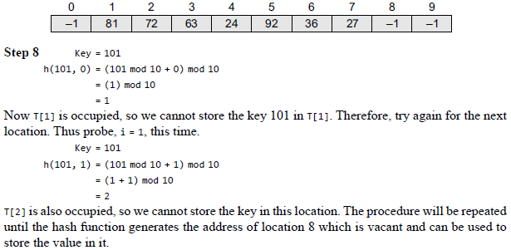
Collisions
Linear Probing

Slide 31
Collisions
Searching a Value using Linear Probing
The procedure for searching a value in a hash table is same as for storing a value in a hash table.
While searching for a value in a hash table, the array index is re-computed and the key of the element stored at that location is compared with the value that has to be searched.
If a match is found, then the search operation is successful. The search time in this case is given as O(1).
If the key does not match, then the search function begins a sequential search of the array that continues until:
the value is found, or
the search function encounters a vacant location in the array, indicating that the value is not present, or the search function terminates because it reaches the end of the table and the value is not present.

Slide 32
Collisions
Searching a Value using Linear Probing
In the worst case, the search operation may have to make n–1 comparisons, and the running time of the search algorithm may take O(n) time.
The worst case will be encountered when after scanning all the n–1 elements, the value is either present at the last location or not present in the table.
Thus, we see that with the increase in the number of collisions, the distance between the array index computed by the hash function and the actual location of the element increases, thereby increasing the search time.

Slide 33
Collisions
Pros and Cons
Linear probing finds an empty location by doing a linear search in the array beginning from position h(k).
Although the algorithm provides good memory caching through good locality of reference, the drawback of this algorithm is that it results in clustering, and thus there is a higher risk of more collisions where one collision has already taken place.
As the hash table fills, clusters of consecutive cells are formed and the time required for a search increases with the size of the cluster.
In addition to this, when a new value has to be inserted into the table at a position which is already occupied, that value is inserted at the end of the cluster, which again increases the length of the cluster.

Slide 34
Collisions
Pros and Cons
Generally, an insertion is made between two clusters that are separated by one vacant location.
But with linear probing, there are more chances that subsequent insertions will also end up in one of the clusters, thereby potentially increasing the cluster length by an amount much greater than one.
More the number of collisions, higher the probes that are required to find a free location and lesser is the performance.
This phenomenon is called primary clustering.
To avoid primary clustering, other techniques such as quadratic probing and double hashing are used.

Slide 35
Collisions
Quadratic Probing
In this technique, if a value is already stored at a location generated by h(k), then the following hash function is used to resolve the collision:
h(k, i) = [h′(k) + c₁i + c₂i²] mod m
where m is the size of the hash table,
h′(k) = (k mod m), i is the probe number that varies from 0 to m–1, and c₁ and c₂ are constants such that c₁ and c₂ ≠ 0.

Slide 36
Collisions
Quadratic Probing
Quadratic probing eliminates the primary clustering phenomenon of linear probing because instead of doing a linear search, it does a quadratic search.
For a given key k, first the location generated by h′(k) mod m is probed.
If the location is free, the value is stored in it, else subsequent locations probed are offset by factors that depend in a quadratic manner on the probe number i.
Although quadratic probing performs better than linear probing, in order to maximize the utilization of the hash table, the values of c₁, c₂, and m need to be constrained.

Slide 37
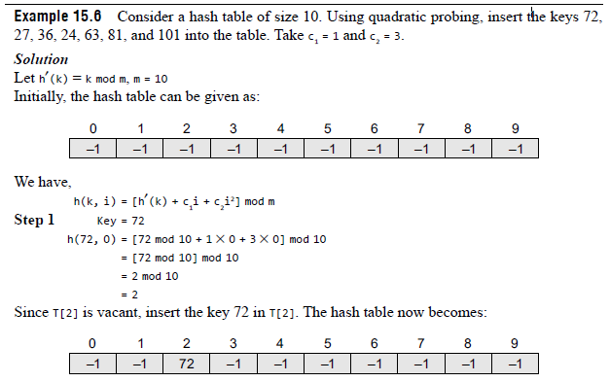
Collisions
Quadratic Probing

Slide 38
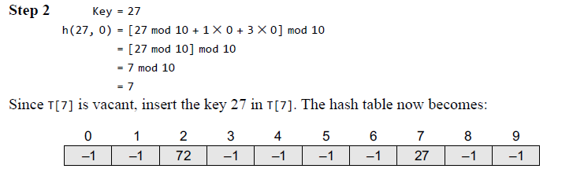
Collisions
Quadratic Probing

Slide 39
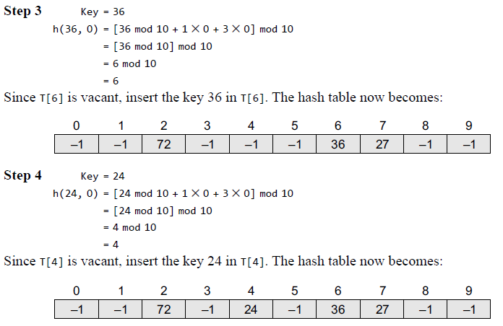
Collisions
Quadratic Probing

Slide 40
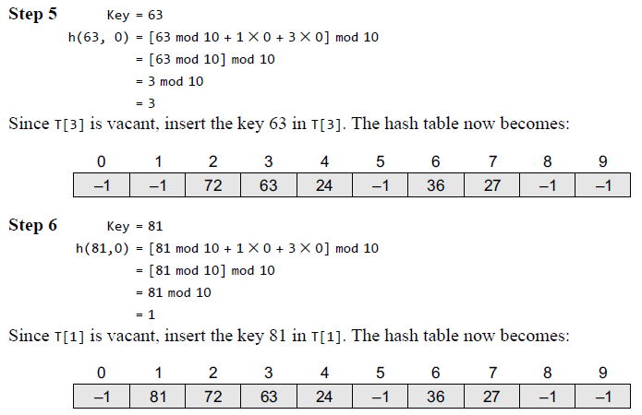
Collisions
Quadratic Probing

Slide 41
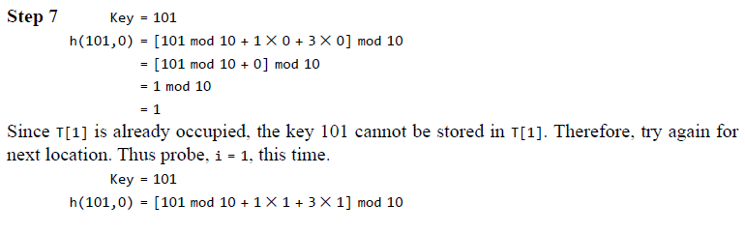
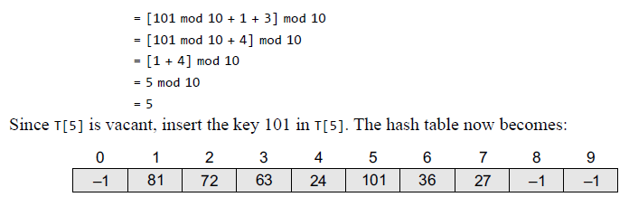
Collisions
Quadratic Probing

Slide 42
Collisions
Searching a Value using Quadratic Probing
While searching a value using the quadratic probing technique, the array index is re-computed and the key of the element stored at that location is compared with the value that has to be searched.
If the desired key value matches with the key value at that location, then the element is present in the hash table and the search is said to be successful.
In this case, the search time is given as O(1).
However, if the value does not match, then the search function begins a sequential search of the array that continues until:
the value is found, or
the search function encounters a vacant location in the array, indicating that the value is not present, or
the search function terminates because it reaches the end of the table and the value is not present.

Slide 43
Collisions
Searching a Value using Quadratic Probing
In the worst case, the search operation may take n–1 comparisons, and the running time of the search algorithm may be O(n).
The worst case will be encountered when after scanning all the n–1 elements, the value is either present at the last location or not present in the table.
Thus, we see that with the increase in the number of collisions, the distance between the array index computed by the hash function and the actual location of the element increases, thereby increasing the search time.

Slide 44
Collisions
Pros and Cons
Quadratic probing resolves the primary clustering problem that exists in the linear probing technique.
Quadratic probing provides good memory caching because it preserves some locality of reference.
But linear probing does this task better and gives a better cache performance.
One of the major drawbacks of quadratic probing is that a sequence of successive probes may only explore a fraction of the table, and this fraction may be quite small.
If this happens, then we will not be able to find an empty location in the table despite the fact that the table is by no means full.
In Example 15.6 try to insert the key 92 and you will encounter this problem.

Slide 45
Collisions
Pros and Cons
Although quadratic probing is free from primary clustering, it is still liable to what is known as secondary clustering.
It means that if there is a collision between two keys, then the same probe sequence will be followed for both.
With quadratic probing, the probability for multiple collisions increases as the table becomes full.
This situation is usually encountered when the hash table is more than full.

Slide 46
Collisions
Double Hashing
To start with, double hashing uses one hash value and then repeatedly steps forward an interval until an empty location is reached.
The interval is decided using a second, independent hash function, hence the name double hashing.
In double hashing, we use two hash functions rather than a single function.
The hash function in the case of double hashing can be given as:
h(k, i) = [h₁(k) + ih₂(k)] mod m
where m is the size of the hash table, h₁(k) and h₂(k) are two hash functions given as h₁(k) = k mod m,
h₂(k) = k mod m', i is the probe number that varies from 0 to m–1, and m' is chosen to be less than m. We can choose m' = m–1 or m–2.

Slide 47
Collisions
Double Hashing
When we have to insert a key k in the hash table, we first probe the location given by applying
[h₁(k) mod m] because during the first probe, i = 0.
If the location is vacant, the key is inserted into it, else subsequent probes generate locations that are at an offset of [h₂(k) mod m] from the previous location.
Since the offset may vary with every probe depending on the value generated by the
second hash function, the performance of double hashing is very close to the performance of the ideal scheme of uniform hashing.
Pros and Cons
Double hashing minimizes repeated collisions and the effects of clustering.
That is, double hashing is free from problems associated with primary clustering as well as secondary clustering.

Slide 48
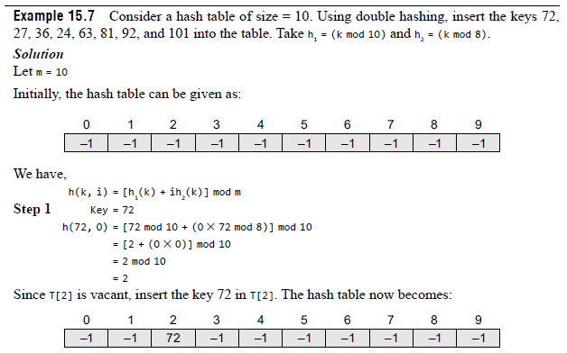
Collisions
Double Hashing

Slide 49
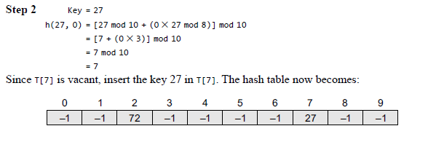
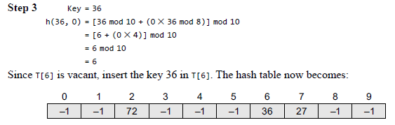
Collisions
Double Hashing

Slide 50
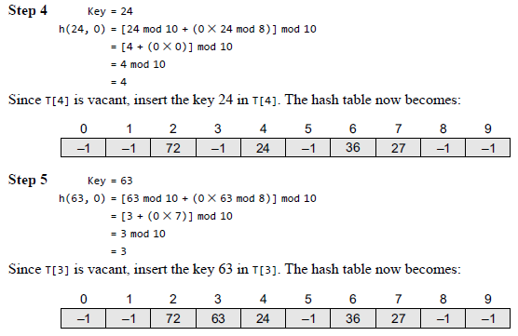
Collisions
Double Hashing

Slide 51
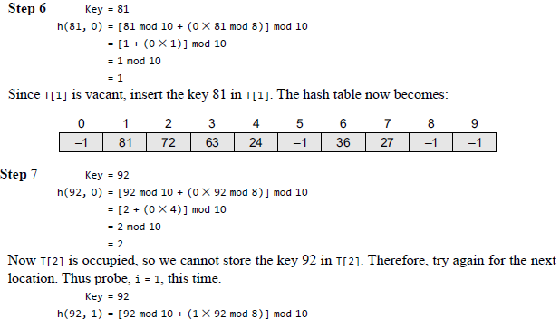
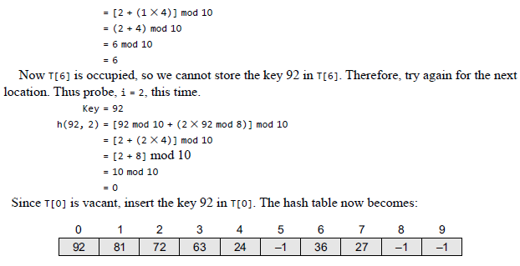
Collisions
Double Hashing

Slide 52
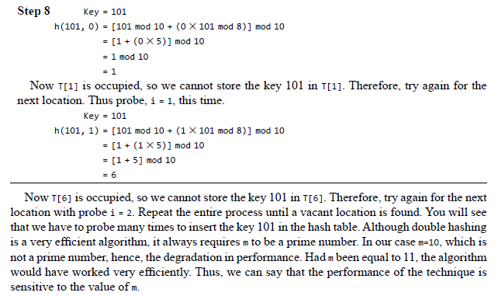
Collisions
Double Hashing

Slide 53
Collisions
Rehashing
When the hash table becomes nearly full, the number of collisions increases, thereby degrading the performance of insertion and search operations.
In such cases, a better option is to create a new hash table with size double of the original hash table.
All the entries in the original hash table will then have to be moved to the new hash table.
This is done by taking each entry, computing its new hash value, and then inserting it in the new hash table.
Though rehashing seems to be a simple process, it is quite expensive and must therefore not be done frequently.

Slide 54
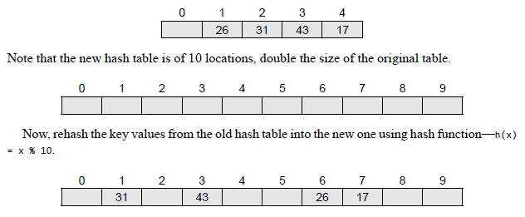
Collisions
Rehashing
Consider the hash table of size 5 given below.
The hash function used is
h(k) = k % 5.
Rehash the entries into to a new hash table.

Slide 55
Collisions
Collision Resolution by Chaining
In chaining, each location in a hash table stores a pointer to a linked list that contains all the key values that were hashed to that location.
That is, location l in the hash table points to the head of the linked list of all the key values that hashed to l.
However, if no key value hashes to l, then location l in the hash table contains NULL.
Figure 15.5 shows how the key values are mapped to a location in the hash table and stored in a linked list that corresponds to that location.

Slide 56
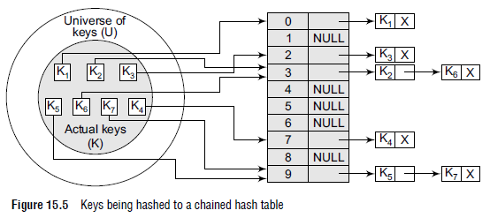
Collisions
Collision Resolution by Chaining

Slide 57
Collisions
Operations on a Chained Hash Table
Searching for a value in a chained hash table is as simple as scanning a linked list for an entry with the given key.
Insertion operation appends the key to the beginning/end of the linked list pointed by the hashed location.
Deleting a key requires searching the list and removing the element.
Chained hash tables with linked lists are widely used due to the simplicity of the algorithms to insert, delete, and search a key.
The code for these algorithms is exactly the same as that for inserting, deleting, and searching a value in a single linked list that we have already studied in Chapter 6.

Slide 58
Collisions
Operations on a Chained Hash Table
While the cost of inserting a key in a chained hash table is O(1), the cost of deleting and searching a value is given as O(m) where m is the number of elements in the list of that location.
Searching and deleting takes more time because these operations scan the entries of the selected location for the desired key.
In the worst case, searching a value may take a running time of O(n), where n is the number of key values stored in the chained hash table.
This case arises when all the key values are inserted into the linked list of the same location (of the hash table).

Slide 59
Collisions
Pros and Cons
The main advantage of using a chained hash table is that it remains effective even when the number of key values to be stored is much higher than the number of locations in the hash table.
However, with the increase in the number of keys to be stored, the performance of a chained hash table does degrade gradually (linearly).
The other advantage of using chaining for collision resolution is that its performance, unlike quadratic probing, does not degrade when the table is more than half full.
This technique is absolutely free from clustering problems and thus provides an efficient mechanism to handle collisions.
However, chained hash tables inherit the disadvantages of linked lists. First, to store a key value, the space overhead of the next pointer in each entry can be significant.
Second, traversing a linked list has poor cache performance, making the processor cache ineffective.

Slide 60
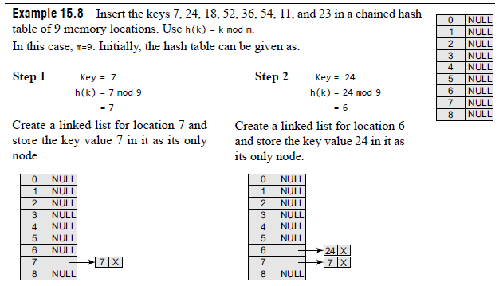
Collisions
Operations on a Chained Hash Table

Slide 61
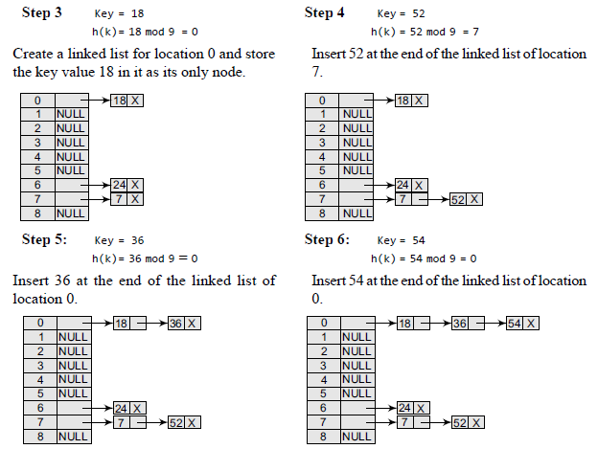
Collisions
Operations on a Chained Hash Table

Slide 62
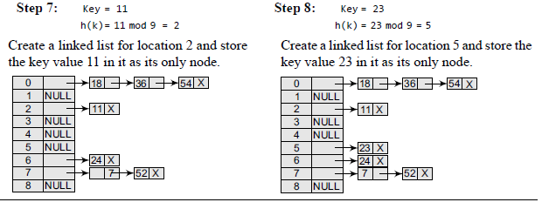
Collisions
Operations on a Chained Hash Table

